Slide 1
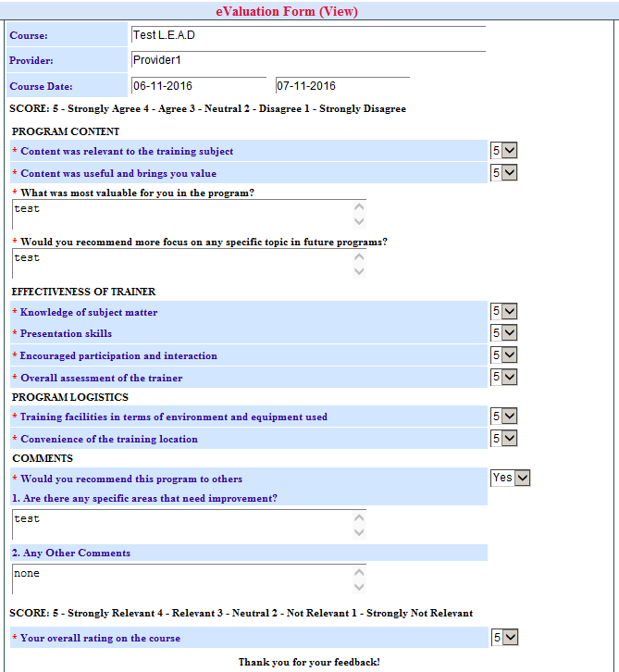
Please revise the training evaluation form based on the following instructions:
Please include heading name to ‘Training Evaluation Form’
2. Please revise to ‘Course Name’
3. Please revise ‘Provider’ to Name of Provider/Name of Trainer
4. Please insert instructions on how to complete evaluation form on line before SCORE
Your feedback is very important to help us continuously improve and evolve. ­­­­­­­­­­­­­­­­­­­Please circle the number which corresponds to your point of view. (Rating scale is 1-5 where 5 is the highest and 1 the lowest) Thank you!
5. Please include OVERALL ASSESSMENT after the instructions. Insert drop down menu with selection from 1-5.
6. Under PROGRAM CONTENT
6.1 Please insert line Duration of training after
‘Content was useful & brings value’.
Please insert drop down menu for the following selection:
Too Short
Just Right
Too Long
7. Please remove ‘Your overall rating on the course’ line. This should be the OVERALL ASSESSMENT line.

Slide 2
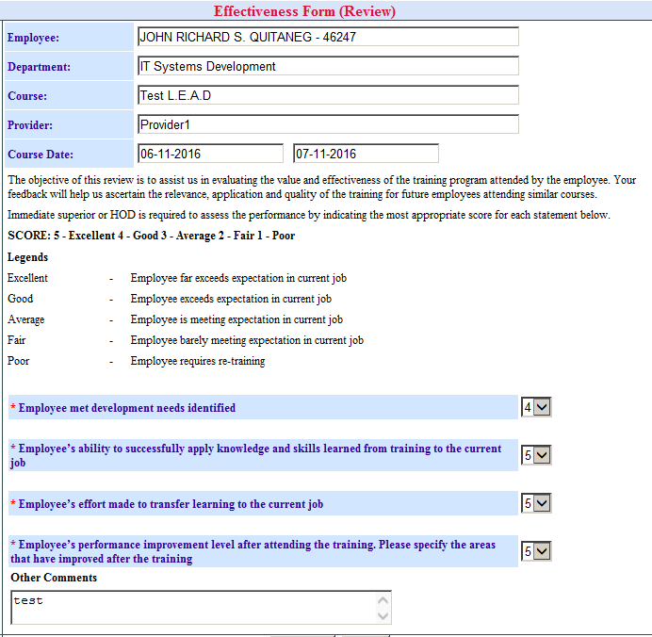
Please revise heading to ‘Training Effectiveness Form’.

